Slide 1

FORKED ASSIGNMENT
How to fork and complete assignments.
Notes:
This power point lesson is specifically designed to be a course outline for the topic, and not exhaustive. The instructor should add their experience and knowledge to the bullet points presented here. These bullet points are key points, or linchpin points in the overall goal of understanding.

Slide 2
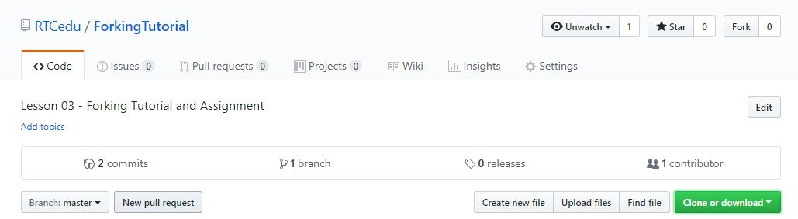
Assignments with Pre-existing Repository
Assignments with pre-existing repositories
  Will be hosted at www.github.com/RTCedu
  Link to repository provided in assignment on Canvas
  The Fork button is in the upper right of the repository
Notes:
Take a moment to show the RTCedu organization page on GitHub.
Ask if anyone has questions on it.
Be sure to specific that it is also used by the CIT BAS, CS BAS, and may be used by the CNT AAS program.

Slide 3
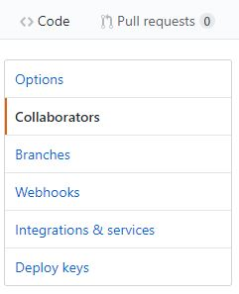

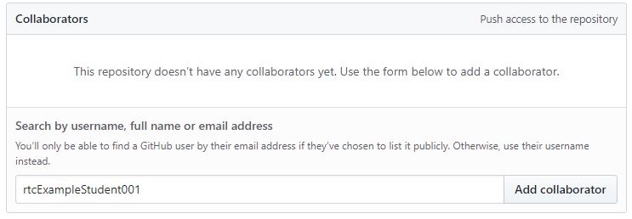
Team Leader Steps
Fork Repository
Add team members as collaboraters:
Settings → Collaborators → Add Collaborators
Notes:
On own repository (after forking) Settings → Collaborators → Search by username → Add Collaborator
Add both team members as collaborators.

Slide 4
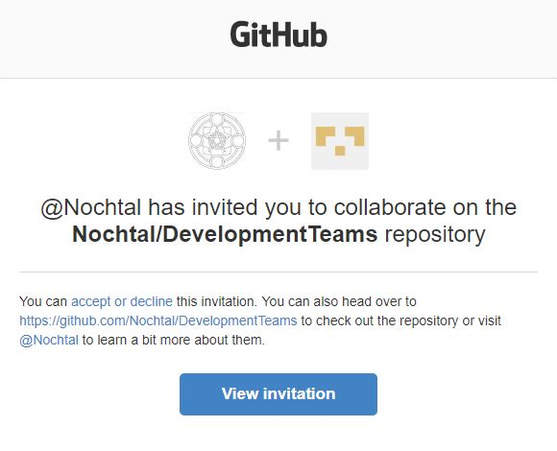
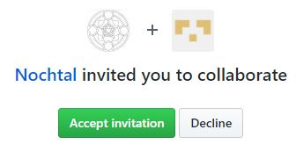
Team Members Invitation
An email will be sent:
Check your email associated with your GitHub account.
The email will look like →
Invitation view:
Notes:
It is important to note: the default Student Package GitHub account is auto generated and assigned to the student’s RTC student email upon registration to the CS/CNT programs.
Once both team members have been added to the team leader’s forked repository, move on to next slide.

Slide 5
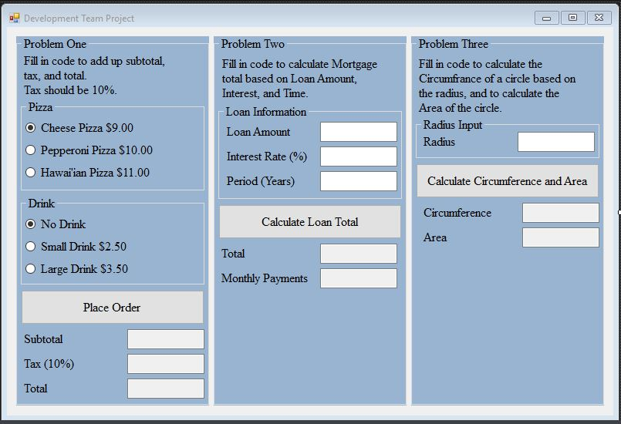
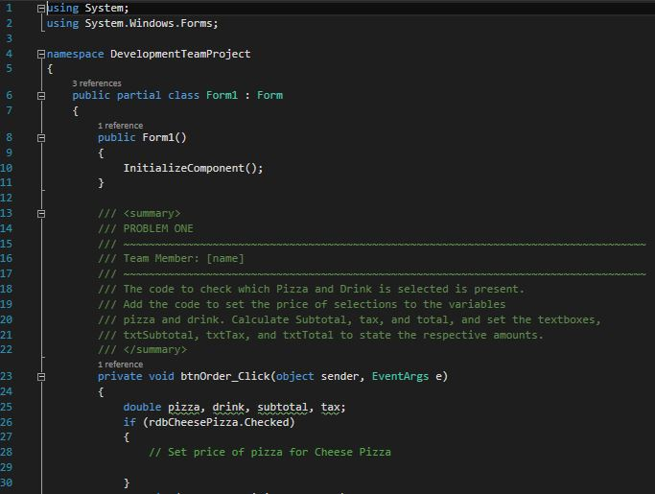
Clone to Local Repository
Notes:
This is what the form design and code should initially look like upon cloning and opening the Repository.
The cloning steps have been left out on purpose to test students ability to do so on their own.

Slide 6


Cloning and Branching
Branch Naming: Problem to be worked on should be referenced in the branch name, as well as either first or last name or initials (Not full name).
Branch: the button to create a branch is next to Push.
Name the Branch:
Start working: Do the work for your problem on your branch.
Notes:
This may confuse some, be prepared to answer questions on the process. Encourage students working with their team to keep everyone on task, and learning the process.
Upon making the branch, GitKraken will automatically switch the local repository to the newly created branch.
Have everyone finish their problem for their team before moving on to the next slide.

Slide 7
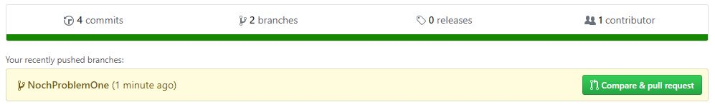
Compare & Pull Request
Branch Complete: Once completed, on GitHub, click the Compare & Pull Request button.
Details! Information provided by Summary and Description of the last push in the branch will be filled into the next page. See next slide for image.

Slide 8
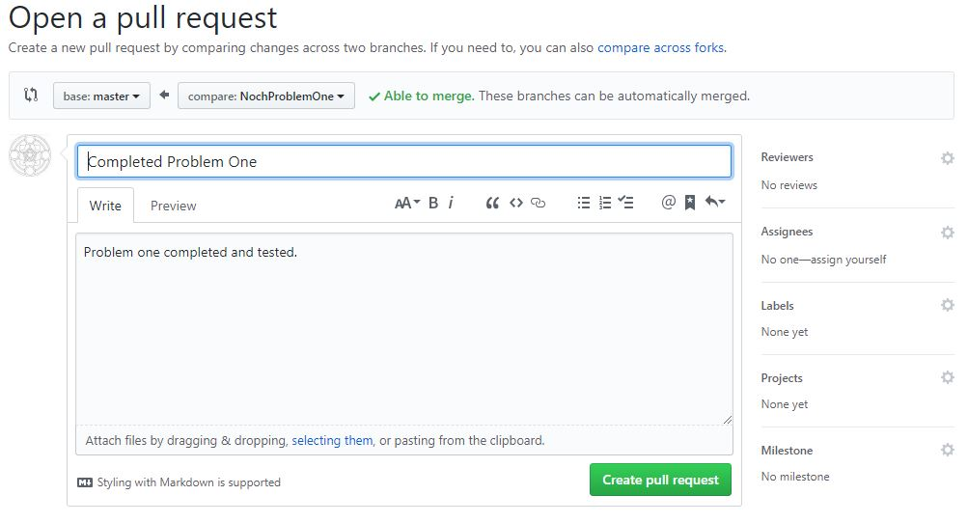
Create Pull Request Page
Notes:
For this project, the pull request is simple:
Make sure base Fork and base on the left match the forked repository and set to master
And on the right it is set to the branch that should be merged in.

Slide 9
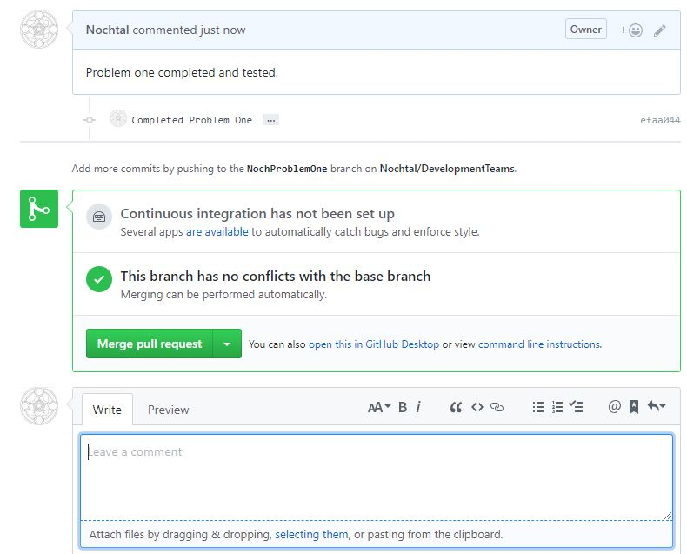
Team Reviews Merge Pull Request
Teams can review the branch being requested for merging, and add comments, files, or notations to the process.
Merge pull request: The team leader, when all are happy with the branch, should merge the pull request.

Slide 10
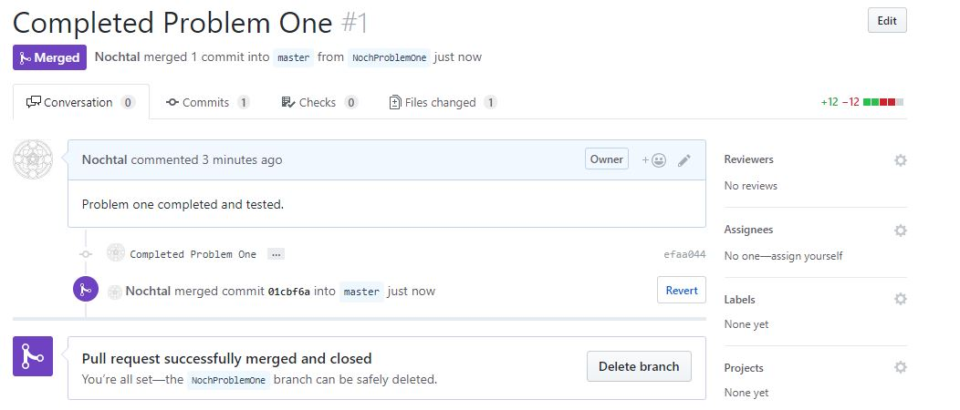
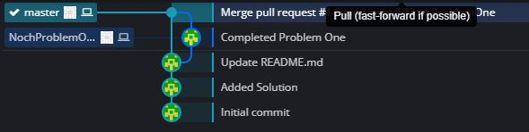
Post Merge(GitHub & GitKraken)
Notes:
It is up to the team if they want to delete the completed branch or not, either way the branch is closed automatically upon successful merging.
Recommend they keep closed branches for now, and in the future to keep closed branches at least until they receive a grade on the assignment.

Slide 11
Complete the Assignment
All 3 Problems: Once all 3 problems are completed and merged into the master branch, the team leader will turn in the assignment on Canvas.
Repository Contributor Tracking: Each team member will be tracked by the repository, instructors can see who contributed what to the project.
  Each push to the origin repository shows who performed the push
  What was edited in each push can be reviewed

